Slide 1
Sensation & Perception
Introduction to Psychology
Ram Manohar Singh

Slide 2
Sensation
The study of sensation is concerned with the initial contact between organisms and their physical environment.
Stimuli
Energies from the world around us that affect us in some way.
Sensory receptors
Located in our eyes, ears, nose, tongue, and elsewhere, are responsible for accomplishing coding task.
Transduction
The translation of physical energy into electrical signals by specialized receptor cells.

Slide 3
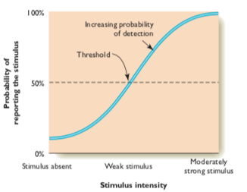
Sensory Thresholds and Signal Detection
Absolute sensory threshold
The intensity at which a given individual can detect a stimulus 50% of the time.
The range of physical stimuli that we and other species can detect seems to be designed in a way that maximizes survival potential.

Slide 4
Complexities in absolute threshold
Homeostasis
sensitivity to stimuli changes from moment to moment
Motivational factors
Costs
Rewards
Signal Detection Theory
A theory suggesting that there are no universal absolute thresholds for sensations.
Detection of a stimulus depends on its physical energy and on internal factors such as the relative costs and benefits associated with detecting the stimulus.

Slide 5
Difference Thresholds
Amount of change in a stimulus required for a person to detect
Just noticeable difference (JND)
The smallest amount of change in a physical stimulus necessary for an individual to notice a difference in the intensity of a stimulus.
Subliminal Perception
A stimulus can influence our behavior even when it is presented so faintly or briefly that we do not perceive it consciously.
Phantom limb

Slide 6
Vision
Hearing
Touch
Taste
Smell
Kinesthetic
Vestibular senses

Slide 7
Perception
The way in which we select, organize, and interpret sensory input to achieve a grasp of our surroundings.
It is the active selection, organization, and interpretation of sensory input.

Slide 8
Cocktail party phenomenon
Perceptual organization
In order to make sense of sensations, people must learn to recognize objects, to read clocks, numbers, and letters, and to judge sizes and distances
Gestalt principles : Whole is more than sum sum of its parts

Slide 9
Figure and Ground
Our tendency to divide the perceptual world into two distinct parts: discrete figures and the background against which they stand out
we selectively attend to certain aspects of our environment while relegating others to the background

Slide 10


Gestalt principles
Nearness
All other things being equal, stimuli that are near each other tend to be constructed, or grouped, together
Similarity
Birds of a feather flock together,”
Stimuli that are similar in size, shape, colour, or form tend to be grouped together

Slide 11


Continuation (continuity)
Perceptions tend toward simplicity and continuity
Closure
Tendency to complete a figure so that it has a consistent overall form

Slide 12

Contiguity
nearness in time and space.
Common region
Stimuli that are found within a common area tend to be seen as a group

Slide 13
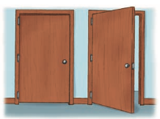
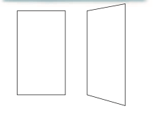
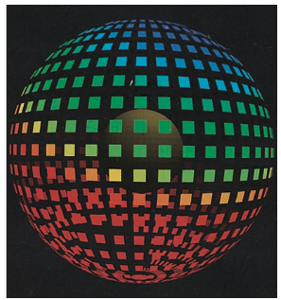
Perceptual constancies
Shape constancy
Size Constancy

Slide 14
Perceptual fallacies
Illusion
Delusion
Hallucination

Slide 15
Role of motivational factors
Bruner’s Experiment

Slide 16
Thank you

